Slide 1


team 20: JEZZBALL Lifesaver
Alexander Marinkovich, Hassan Hamid, Steven Guan, Winston Chu

Slide 2
Summary
JezzBall is a puzzle arcade game in which the player must capture parts of a rectangular space by dividing it with horizontal and vertical lines. These lines act as barriers to the balls. The objective is to capture at least 75% of the space.
If a ball collides with a line while it is currently being built, the player loses a life, and that end of the line breaks.
Our project aims to predetermine whether or not the player will lose a life if they build a line. The model will figure this out based on the current cursor position and cursor orientation (vertical or horizontal), as well as with a list of the current ball positions and velocities. It will also need a map of which cells have been captured already.

Slide 3
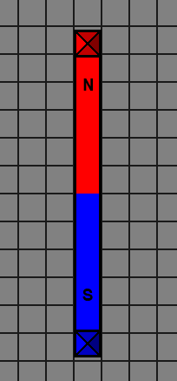
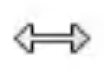

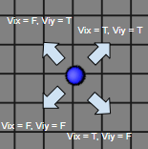
Propositions
H – This is true if the horizontal orientation is selected
V – This is true if the vertical orientation is selected
M_{(x, y)} – This is true if cell (x, y) is where the cursor/mouse is (i.e. the starting position of where the line is created)
C_{(x, y)} – This is true if cell (x, y) is captured (i.e. the black cells)
P_{(i, x, y, t)} – This is true if ball i's position is at cell (x, y) at time t
B_{(D, t)} – This is true if the builder of direction D (can be N, E, S, W) is still building at time t
L – This is true if the player will lose a life from creating a line
In JezzBall, the balls only move in the 4 diagonals, which can be modelled using the following 2 propositions:
V_{ix} – This is true if ball i is currently moving in the positive x direction, false if the negative x direction
V_{iy} – This is true if ball i is currently moving in the positive y direction, false if the negative y direction
North and south builders

Slide 4
Constraints
The cursor's orientation can only be either vertical or horizontal, but not both
(H ∨ V) ∧ ¬(H ∧ V)
The position of a ball cannot coincide with the position of a captured cell
P_{(i, x, y, t)} → ¬C_{(x, y)}
Only one horizontal or vertical pair of builders can be actively building at one given moment
(B_{(N, t)} ∨ B_{(S, t)}) → ¬(B_{(E, t)} ∨ B_{(W, t)})
(B_{(E, t)} ∨ B_{(W, t)}) → ¬(B_{(N, t)} ∨ B_{(S, t)})

Slide 5
End

